Slide 1
Agro Prognostics Based on Characteristics of the agricultural Environment Using Machine Learning
By
Uday Kiran Reddy Aduri (RA1911027010108)
Pavan Kiran Kuchipudi (RA1911027010084)
ICRTDAO-66

Slide 2
Introduction
Crop prediction in agriculture is a complicated process and multiple models have been proposed and tested to this end. The problem calls for the use of assorted datasets, given that crop cultivation depends on biotic and abiotic factors. Biotic factors include those elements of the environment that occur as a result of the impact of living organisms (microorganisms, plants, animals, parasites, predators, pests), directly or indirectly, on other living organisms. This group also includes anthropogenic factors (fertilization, plant protection, irrigation, air pollution, water pollution and soils, etc.). These factors may contribute to the occurrence of many changes in the yield of crops, cause internal defects, shape defects and changes in the chemical composition of the plant yield.

Slide 3
Abstract
Agriculture is a growing field of research. In particular, crop prediction in agriculture is critical and is chiefly contingent upon soil and environment conditions, including rainfall, humidity, and temperature. In the past, farmers were able to decide on the crop to be cultivated, monitor its growth, and determine when it could be harvested. Today, however, rapid changes in environmental conditions have made it difficult for the farming community to continue to do so. Consequently, in recent years, machine learning techniques have taken over the task of prediction, and this work has used several of these to determine crop yield. To ensure that a given machine learning (ML) model works at a high level of precision, it is imperative to employ efficient feature selection methods to preprocess the raw data into an easily computable Machine Learning friendly dataset.

Slide 4
Literature Survey
S. No | Title | Author | Journal Details | Interference
1. | Role of data mining in education for improving soil performance for social change | Myla Arcinas, Guna Sekhar Sajja, Shazia Asif, Sanjeev Gour, Ethelbert Okoronkwo, Mohd Naved | June 2021 Türk Fizyoterapi ve Rehabilitasyon Dergisi/Turkish Journal of Physiotherapy and Rehabilitation | Helped to discover the characteristics that impact students' choice of a field of study in higher education. A paradigm for predicting student success is also provided , improved and assessed.
2. | Soil Data Analysis Using Classification Techniques and Soil Attribute Prediction | Jay Gholap, Anurag Ingole, Jayesh Gohil, Shailesh Gargade | June 2012 International Journal of Computer Science Issues Agricultural research has been profited by technical advances such as automation) | Helps at analysis of soil dataset using data mining techniques. It focuses on classification of soil using various algorithms available.
SLIDE NO. :- 6

Slide 5
S. No | Title | Author | Journal Details | Interference
3. | Response surface methodology: A retrospective and literature survey | Raymond H. Myers ,Douglas C. Montgomery ,G. Geoffrey Vining ,Connie M. Borror &Scott M. Kowalski | Feb 2018 A Quarterly Journal of Methods, Applications and Related Topics Volume 36, 2004 - Issue 1 | In this review paper we focus on Response Surface Methdology activities since 1989. We discuss current areas of research and mention some areas for future research.
4. | ChapterAnalysis of Data Mining Algorithms for Predicting Rainfall, Crop and Pesticide Types on Agricultural Datasets | Mustafa Omer Mustafa Nahla Mohammed Elzein Zeinab M. SedAhmed | October 2022 In book: International Conference on Information Systems and Intelligent Applications (pp.721-732) | The aim of this study is to classify different data features and implement various algorithms as it relates to agricultural big data. Additionally, a given dataset is preprocessed to ensure that relevant data is present in all datasets
SLIDE NO. :- 7

Slide 6
S. No | Title | Author | Journal Details | Interference
5. | Applying naive Bayes classification technique for classification of improved agricultural land soils. | Singaraju Jyothi, Peyakunta Bhargavi | August 2019 IJCSNS International Journal of Computer Science and Network Security, VOL.9 No.8, August 2019 | This research aimed to assess these new data mining techniques and apply them to a soil science database to establish if meaningful relationships can be found.The advances in computing and information storage have provided vast amounts of data.
6. | Biotic components influencing the yield and quality of potato tubers | A.J. Michel , S.M. Sinton1 , R.E. Falloon, F.A. Shah1 , S.J. Dellow1 , S.J. Pethybridge | September 2015 “Building Productive, Diverse and Sustainable Landscapes “ Proceedings of the 17th ASA Conference, 20 – 24, Hobart, Australia. | Potato yields in Canterbury have remained static at c. 60 t/ha for the last decade. Soil-borne diseases (Rhizoctonia stem cancer and Spongospora root infection) were identified as consistent factors in reduced yields, along with subsurface soil compaction and inadequate irrigation management.
SLIDE NO. :- 8

Slide 7
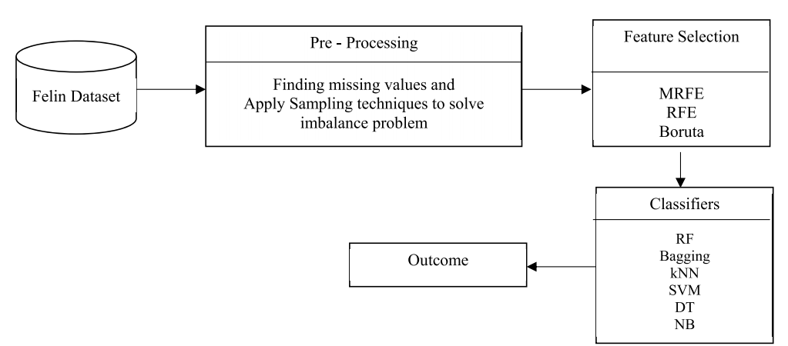
Architecture

Slide 8
Implementation

Slide 9
Dataset Description
The following Parameters are considered:
Nitrogen
Phorsporous
Potassium
Temperature
Humidity
Ph(of soil)
Rainfall(in mm)
SLIDE NO. :- 16

Slide 10
Methodology
1. importing the packages: using this module we will import all packages
2. exploring the dataset – Crop recommendation Data: Using this module we will upload dataset
3. data processing & cleaning: Using this module we will read data for processing

Slide 11
4. visualization using seaborn & matplotlib: Using this module will get graphical representation of information and data.
5. Splitting the data to train and test: Using this module will divide dataset into train & test for processing
6. building the model with and without feature selection - Feature Selection (SMOTE, ROSE, RFE, MRFE, BORUTA, MEMOTE) - KNN - Naive Bayes - Bagging Classifeir - Random Forest - Decision Tree - SVM - Gradient Boosting - Voting Classifier

Slide 12
7.training the model: Using this module algorithms trained for processing & prediction building the model with Voting Classifier since it gives better accuracy comparing with Other Models
8.Flask Framework with Sqlite for signup and signin: Using this module user will get register & login importing the packages
9.User gives input as Feature Values : Uisng this module user gives input for prediction the given input is preprocessed for prediction
10.Trained model is used for prediction: Using this module predicted result displayed final outcome is displayed through frontend

Slide 13
Environment
Software requirements deal with defining software resource requirements and prerequisites that need to be installed on a computer to provide optimal functioning of an application. These requirements or prerequisites are generally not included in the software installation package and need to be installed separately before the software is installed.
Visual Studio Community Version
Nodejs ( Version 12.3.1)
Python IDEL ( Python 3.7 )

Slide 14
Algorithms
K-Nearest Neighbours Algorithm:
The abbreviation KNN stands for “K-Nearest Neighbour”. It is a supervised machine learning algorithm.
The algorithm can be used to solve both classification and regression problem statements. The number of nearest neighbours to a new unknown variable that has to be predicted or classified is denoted by the symbol ‘K’.
Bagging Classifier:
A Bagging classifier is an ensemble meta-estimator that fits base classifiers each on random subsets of the original dataset and then aggregate their individual predictions (either by voting or by averaging) to form a final prediction

Slide 15
Naive Bayes:
The Naive Bayes classification algorithm is a probabilistic classifier. It is based on probability models that incorporate strong independence assumptions.
The independence assumptions often do not have an impact on reality. Therefore they are considered as naive.
Random Forest:
Random Forest is a popular machine learning algorithm that belongs to the supervised learning technique. It can be used for both Classification and Regression problems in ML.
As the name suggests, "Random Forest is a classifier that contains a number of decision trees on various subsets of the given dataset and takes the average to improve the predictive accuracy of that dataset

Slide 16
Decision Tree:
Decision trees use multiple algorithms to decide to split a node into two or more sub-nodes.
The creation of sub-nodes increases the homogeneity of resultant sub-nodes. In other words, we can say that the purity of the node increases with respect to the target variable.
Support vector machines:
Support Vector Machine or SVM is one of the most popular Supervised Learning algorithms. Primarily, it is used for Classification problems in Machine Learning.
The goal of the SVM algorithm is to create the best line or decision boundary that can segregate n-dimensional space into classes so that we can easily put the new data point in the correct category in the future. This best decision boundary is called a hyperplane.

Slide 17
Gradient Boosting:
Gradient boosting is a machine learning technique used in regression and classification tasks, among others.
It gives a prediction model in the form of an ensemble of weak prediction models, which are typically decision trees. It generalizes the other methods by allowing optimization of an arbitrary differentiable loss function.
Voting Classifier:
A voting classifier is a machine learning estimator that trains various base models or estimators and predicts on the basis of aggregating the findings of each base estimator.
The aggregating criteria can be combined decision of voting for each estimator output.

Slide 18
Results
After visualisation , the data is cleaned and splitted for train and test module.
Feature selections are invoked and applied several algorithms.
Thereby compared the predicted and tested data and calculated accuracy by score method().
Hence the voting classfier holds high accuracy for given data and be used for Agricutural Analytics.
SLIDE NO. :- 32

Slide 19
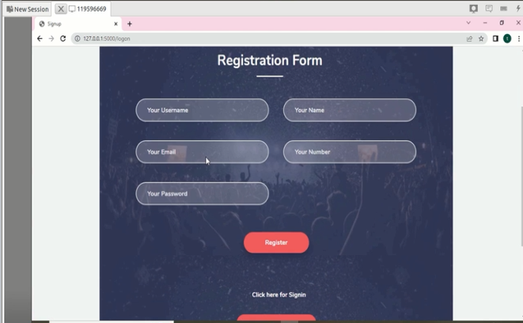

Slide 20
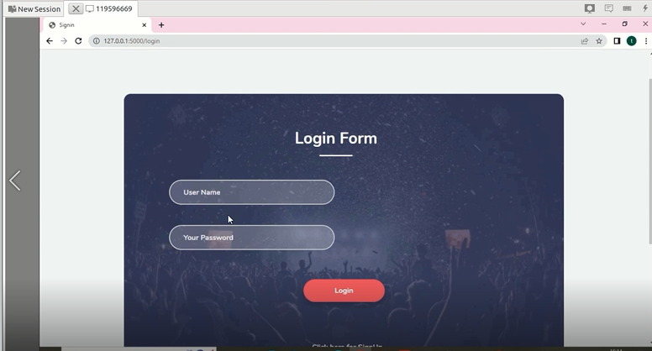

Slide 21
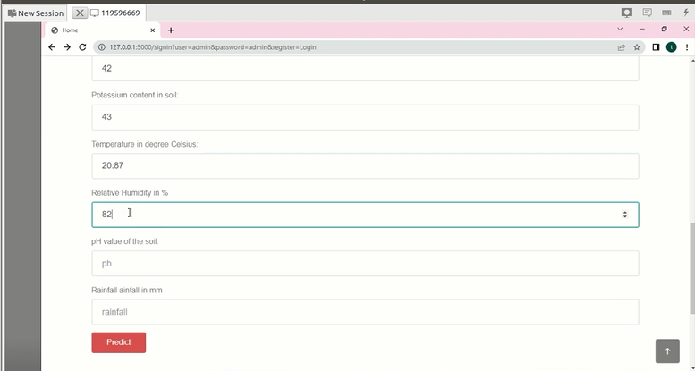

Slide 22
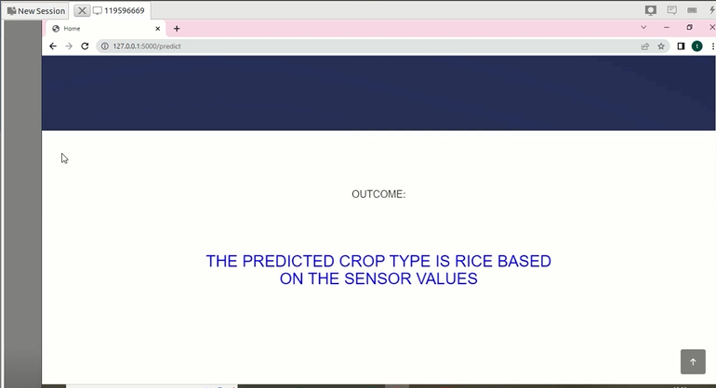

Slide 23
Conclusion
Predicting crops for cultivation in agriculture is a difficult task. This paper has used a range of feature selection and classification techniques to predict yield size of plant cultivations. The results depict that an ensemble technique offers better prediction accuracy than the existing classification technique. Forecasting the area of cereals, potatoes and other energy crops can be used to plan the structure of their sowing, both on the farm and country scale. The use of modern forecasting techniques can bring measurable financial benefits.

Slide 24

Future Scope
Expanding the project with more crop yield data for a wider range of crops will increase its usability.
Can be deployed with cloud support to make the website prototype accessible as a usable commodity in the digital world.
Could include recommended fertilizers and pesticides for each crop.
SLIDE NO. :- 39

Slide 25
Applications
Providing aid for farmers to choose their crop including the scientific factors like the contents of nitrogen and phosporous etc.
Quality of the crops can be maintained since we calcuated all effecting factors.
Drastic climatic changes are estimated and made compensated with the type that predicted.
Intimated to farmers earlier not grow same crop as previous if it’s not under same sustainabilities.
SLIDE NO. :- 37

Slide 26
Extension
In the base paper, the author mentioned Machine Learning models (NB, Bagging, RF, DT, SVM),in which RF got 87%.
As an extension we have applied Voting Classifier and Gradient Boosting, in which Voting Classifier got 99.7%. So with Voting Classifier we build the model is used for predicting the results.
For this project we will implement front end using Flask Framework as an extension.
We will provide user authentication using sqlite3 database. Base paper link https://ieeexplore.ieee.org/document/9721191

Slide 27
References
[1] R. Jahan, ‘‘Applying naive Bayes classification technique for classification of improved agricultural land soils,’’ Int. J. Res. Appl. Sci. Eng. Technol., vol. 6, no. 5, pp. 189–193, May 2018.
[2] B. B. Sawicka and B. Krochmal-Marczak, ‘‘Biotic components influencing the yield and quality of potato tubers,’’ Herbalism, vol. 1, no. 3, pp. 125–136, 2017.
[3] B. Sawicka, A. H. Noaema, and A. GÆowacka, ‘‘The predicting the size of the potato acreage as a raw material for bioethanol production,’’ in Alternative Energy Sources, B. Zdunek, M. OlszÆwka, Eds. Lublin, Poland: Wydawnictwo Naukowe TYGIEL, 2016, pp. 158–172.

Slide 28
[4] B. Sawicka, A. H. Noaema, T. S. Hameed, and B. Krochmal-Marczak, ‘‘Biotic and abiotic factors influencing on the environment and growth of plants,’’ (in Polish), in Proc. Bioró»norodno–¢ Środowiska Znaczenie, Problemy, Wyzwania. Materia“y Konferencyjne, Pu“awy, May 2017. [Online]. Available: https://bookcrossing.pl/ksiazka/321192
[5] R. H. Myers, D. C. Montgomery, G. G. Vining, C. M. Borror, and S. M. Kowalski, ‘‘Response surface methodology: A retrospective and literature survey,’’ J. Qual. Technol., vol. 36, no. 1, pp. 53–77, Jan. 2004.

Slide 29


